Slide 1
Classification and Sentiment
W266: Natural Language Processing

Slide 2
Peeking ahead...
Week 1- 2: NN Basics & Training
Week 3: Classification & Sentiment
Week 4: Part of Speech + Parsing
Week 5: Convolutional Neural Networks (CNNs)
Week 6 - 7: Language Models
Project Proposal Due Feb 6
Week 8: Machine Translation
Week 9: Advanced MT: Transformers & Transfer Learning
Week 10: Entities/Information Extraction
Week 11: Summarization and a touch of question answering
Week 12: Document Classification
Week 13: Information Retrieval

Slide 3
Announcements
Assignment 2 (Neural Networks) - released this past Saturday 01/16
Due Sunday, Jan 24 (Tuesday 01/26 if you use late days)
Assignment 3 to be released Saturday 01/23.
Paper reading sessions:
None this week
Mark: Next Friday 1/29 5:40 pm PST
Climbing toward NLU: On Meaning, Form, and Understanding in the Age of Data and A robot wrote this entire article. Are you scared yet, human? GPT-3
Project Proposals - Due 02/06!
Details today.
Concerns?

Slide 4
The plan...
Final Project
Review
Classification problems
Text Representation and Embeddings
Classification and Neural Networks

Slide 5
Final Project:
Overview + Model Zoo
W266: Natural Language Processing

Slide 6
Final Project
This is all on the course GitHub!
-> Final Project Guidelines <-
Open-ended final project - your chance to explore & apply NLP!
Some project types:
Apply existing NLP algorithm(s) to a new dataset
Develop a new NLP algorithm or technique
Adapt techniques from a recent paper to a new domain
Use NLP algorithms to find patterns or trends in data
One requirement: language must be the main part of your project.
Notes:
Applied projects more common, but you’re encouraged to explore more abstract or fundamental computational linguistics tasks! (these tend to be fun projects)
All projects will require reading the literature for background, related work, and importantly, ideas.

Slide 7
Final Project: Timeline
Paper Reading Sessions (Coming Soon!)
Project proposal (Feb 6th)
Write-up Milestone (Optional - Mar 13)
Project write up (due Apr 10 - HARD DEADLINE)
Final presentations (in-class Apr 12 - 17)
In total, 60% of course grade! Important to start early.

Slide 8
Finding Ideas and Datasets
Best source: read papers! See what people have tried, what data they used.
The Association of Computational Linguistics (ACL) Anthology
NAACL, ACL, EMNLP, NeurIPS, ICML, SigKDD, WSDM
Google Scholar and the arXiv (quality may vary)
More here: Project Proposal Guidelines
Stanford posts open lists of class projects:
cs224n (2000-2017), cs224d (2015, 2016, 2017)

Slide 9
Types of Problems/Tasks
NLP ≈ (machine learning) + (linguistics) + (all sorts of algorithms) + (data)
Text classification / regression
Textual similarity
Sequence labeling
Information retrieval / information extraction
Question answering
Semantics, natural language inference
Summarization
Machine translation
Dialog
Notes:
Color coded by difficulty. Intuition and domain understanding are very important! Pick a problem that you find exciting. Don’t be afraid to skip ahead in the course readings & async to learn more about a topic of interest.
Semantics, NLI, and dialog aren’t covered in this course - but we’re happy to talk about them!

Slide 10
Tasks -> problem structures -> Architectures*
Task | Standard Problem Structure | Architectures
Question Answering | Span Detection | Transformers, Sequence labeling
Machine translation | Sequence to sequence | Transformers, Encoder - decoder
Abstractive Summarization | Sequence to sequence | Transformers, Encoder - decoder
Natural Language Inference (NLI) | Text Pair Classification | Various
Sentiment | Classification | Transformers, CNN
Semantic Role Labeling (SRL) | Sequence Labeling | LSTM
Relation Extraction | Classification | various
Goal Directed Dialog | Sequence to sequence | Encoder - decoder
*No claim of completeness is made

Slide 11
Finding Data
Data is usually the limiting factor in NLP problems (as with most ML)
Most tasks in the async have lots of data available
Interested in a new domain? Be sure you can get data!
Potential data types / sources:
Labeled corpora (Penn Treebank, sentiment data, much, much more)*
Large corpora (Gigaword, Wikipedia, Common Crawl, Google Web 1T)
News articles (NYT, WSJ, Reuters, etc.)
Social media (reddit, Twitter, etc.)
https://datasetsearch.research.google.com/
???
Notes:
Lots of text that has some structure associated with is, which often lends itself to rich machine learning tasks. For example: summarization data is (historically) often derived from news headlines, paired with the articles. Or reddit, which has upvotes and comment thread structure.

Slide 12
Getting Data
Have access to many paywalled corpora through UC Berkeley
Linguistic Data Consortium corpora:
Recent corpora: http://oskicat.berkeley.edu/search~S1?/aLinguistic+Data+Consortium%7C
Older corpora: Collections and Archives

Slide 13
Common pitfalls
If you only remember two things…
Read existing research. (Do not start from scratch!)
Look at your data before you submit your proposal.
(Corollary: if you want to scrape data, start working on that now)
Notes:
Data collection & processing takes more time than you think - don’t leave it to the last minute and find yourself without time to do the fun parts (experiments)!

Slide 14
Six sample projects
This folder contains copies of six successful project papers from earlier semesters that the authors agreed to share:
Comparison of Unsupervised Data Augmentation with BERT and XLNet
Evaluating World Knowledge Representation in Language Models
Transformers to the Rescue: Extracting Insight and Understanding from a RoBERTa Model Tuned for Classifying Disaster Information
Propaganda Span Identification
Semantic Similarity and Response Prediction for Programming QandA
Unsupervised Data Augmentation Experimentation

Slide 15
Review: Key Concepts from Weeks 1,2
W266: Natural Language Processing

Slide 16
Information Theory
What did we learn?:
Information I ~ -log(p).
Entropy S = Expected(Information) = - ∑ p log(p)
Cross-entropy, if our anticipated probabilities q are different than the true probabilities p (i.e., q ≠ p):
H = - ∑ p log(q)
Often our cost function! Minimizing drives q → p
Notes:
But this is just the surface!

Slide 17
Networks and Matrices
Mini-batch size = 4
H
X
H
O
H
H
O
X
H
W
W
W
softmax(z)
relu(z)
relu(z)
x
x
x
+
=
+
=
+
=
b
P
b
z
z
b
z
Notes:
Pink = input (4 observations)
H1 = blue (4 hidden states but W and b are same size as they get re-used for each observation)
H2 = yellow (4 hidden states but W and b are same size as they get re-used for each observation)
Output = green (4 predictions)

Slide 18
Neural Nets
Feature index m of first NN layer
Example index A
{
z_{m}
x^{A}_{i}
x^{A}_{i} W_{im} + b_{m}
Relu(z_{m})
y’
Feature index i
{
i
{
{
A
i
b
z =
x
W
+
b
{
m
m
First NN Layer
Notes:
But this is just the surface!

Slide 19
Neural Nets
Sigmoid Or Softmax
Output layer
(“softmax layer”)
Affine
Nonlinearity
Fully-connected layer 2
Affine
z = xW + b
dim(x) = k
dim(z) = m
shape(W) = k x m
dim(b) = m
Affine
Nonlinearity
Fully-connected layer 1
Affine
x₁ x₂
Notes:
Not to be confused with how batteries work

Slide 20
Text Classification
W266: Natural Language Processing

Slide 21
Text Classification from an ML perspective
Input:
x = “this is a sentence, and we want to classify it.”
Output:
y ∈ {0, 1} or y ∈ {0,...,k-1}
Applications:
Sentiment polarity (y ∈ {negative, positive})
Document classification (y ∈ {topic1, topic2, topicN})
(...)
Notes:
But this is just the surface!

Slide 22
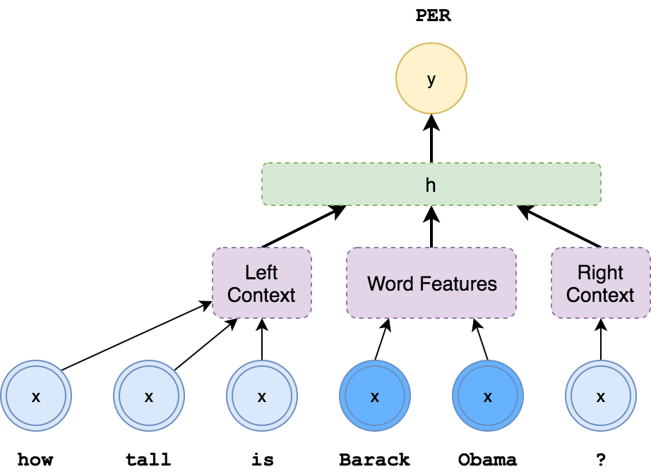
Text Classification Tasks and
Problem Structures
Example: named entity tagger (NER)
Paraphrase detection:
x = (sentence_1, sentence_2)
y ∈ {0,1}
Entailment:
x = (sentence_1, sentence_2)
y ∈ {L-entail, R-entail, contradict, other}
POS or entity tagging*:
x = (word, nearby words)
y ∈ {NOUN, VERB, ADJ, …} or y ∈ {PER, LOC, ORG, …}
Parsing*:
x = (stack, buffer), y ∈ {shift, L-reduce, R-reduce}
Notes:
* For tagging and parsing and other structured prediction tasks (which we’ll discuss in weeks 4, 9-13), simple classifiers are often a key component of high-performing systems. The classifier runs in a loop and extracts features from some state machine in order to make decisions that contribute to the final output.
Many reinforcement learning systems also work this way, where a simple classifier on the world state predicts an action to take.

Slide 23
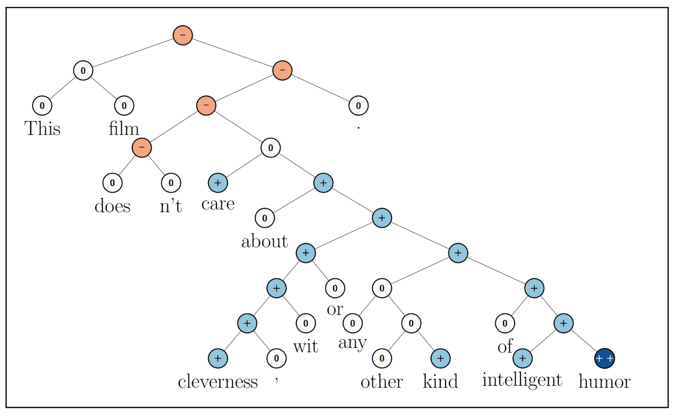
Sentiment Analysis
Given a text, predict whether it expresses positive or negative sentiment.
Variants Binary; star rating; Aspect Based Sentiment Analysis (ABSA); Distributional
Applications Market research; customer service; financial market predictions
Tricky for complex sentences!
In practice, simple methods work well.
Socher et al. (2013)
Notes:
Details in async

Slide 24
Text Representation
and
Word Embeddings

Slide 25
Represent words with simple tokens
Tokenization (process) also called Segmentation
Split raw text into a sequence of word forms (types) that occur in your vocabulary
Don’t underestimate the difficulty of tokenizing $50,000.
Do ⧫ n’t ⧫ underestimate ⧫ the ⧫ difficulty ⧫ of ⧫ tokenizing ⧫ $ ⧫ 50 ⧫ , ⧫ 000 ⧫ .
Different algorithms perform tokenization
Split on white space, Maximum Matching Segmentation, BPE (byte-pair encoding), wordpiece
The unique “tokens” make up the “vocabulary”
Vocabulary size affects softmax computation
Notes:
Details in async

Slide 26
Represent adjacency relations with n-grams
Problem
Many words co-occur frequently in phrases
How can we capture these relations in a simple/cheap way?
Approach
Instead of a token for each word we have a token for each word pair (bi-gram) or multi-word grouping (n-gram)
‘Can we learn relations from context’ becomes:
‘can we’
‘we learn’
‘learn relations’
‘relations from’
‘from context’

Slide 27
Sparsity: drawbacks to simple tokens
Train like to fly to honolulu 20 just flew back from beijing 10 just flew back from boston 35 just flew back from honolulu 65 i grew up near dallas 5 I grew up near boston 3 moved back home from chicago 8 moved back home from dallas 8 always wanted to visit london 7 always wanted to visit boston 5 Evaluation/Application always wanted to visit beijing ?
Are there drawbacks of modeling all words separately?
Words that described similar types of things can be used in similar contexts. Specific contexts will not be observed with all words having the same type (e.g. city names)
What if we modeled: P(<city name> | "always wanted to visit")
Notes:
Would be nice if we can bridge between contexts, by multi-hop reasoning: {beijing, boston, honolulu} are similar, and {boston, london} are similar, so maybe {london, beijing} are similar, transitively?

Slide 28
Term Document Matrix
doc1
doc2
doc3
Three documents:
I like dogs
I prefer cats
I like dogs and cats and fish
Each doc represented by a vector (a bag of words)
Vectors contain counts (tf) or weights (tf*idf from information retrieval)
Each word in doc is treated as a dimension so can compute “similarity” as cosine of angle between vectors. (Vector Space Model)
and
cats
dogs
I
like
prefer
fish

Slide 29
Term Term Matrix
and
cats
dogs
I
like
prefer
fish
Represent each word as a vector based on co-occurring words (distributional hypothesis):
What size context window?
Sentence, paragraph, document
What kinds of weighting schemes can I use?
tf, PMI
Do we represent words or lemmas or parts of words or multi-words?
Vocabulary size issue
How do we deal with sparseness of large vocabulary matrix?
Dimension reduction
Embeddings
and
2
2
1
2
1
2
cats
1
2
1
2
1
1
1
dogs
1
1
2
2
2
1
I
2
2
2
3
2
1
1
like
1
1
2
2
2
1
prefer
1
1
1
fish
1
1
1
2
1
1

Slide 30
Word Embeddings
Goal
Represent words in a way that we can bridge between contexts!
Similar words should have similar representation
Approach
Map words to vectors, called ‘embeddings’
Learn embeddings from context
Notes:
Would be nice if we can bridge between contexts, by multi-hop reasoning: {beijing, boston, honolulu} are similar, and {boston, london} are similar, so maybe {london, beijing} are similar, transitively?

Slide 31
Word Embeddings
Goal
Represent words in a way that we can bridge between contexts!
Similar words should have similar representation
Approach
Map words to vectors, called ‘embeddings’
Learn embeddings from context
Benefits
Natural solution to sparsity problems
Good basis for synonym & word relationship analysis
Also good input format for ML models
“london”
“berlin”
“spaceship”
Notes:
Would be nice if we can bridge between contexts, by multi-hop reasoning: {beijing, boston, honolulu} are similar, and {boston, london} are similar, so maybe {london, beijing} are similar, transitively?

Slide 32
Mathematically equivalent: one-hot & word vectors
Usually presented as a “lookup” in some table, but…
(Only) think of a word as a one-hot vector:
X = [0 0 1 … 0 0 …. 0 0 0] ← 10k dimension?
Then we do matrix multiplication:
“the”
E =
0 0 1 0 0 0 0
W
X
Vector for “the”
Word Embeddings!
Reasonable that similar words end up with similar vectors
Notes:
Key idea: map discrete things (words) into a continuous feature space.
Conceptually, just a big matrix multiply. But since one-hot vector is very sparse, convenient to just extract the column by indexing. So often we’ll refer to this as a “lookup”. (In fact, you can even shard embeddings across different servers, and just pull in the one you need!)

Slide 33
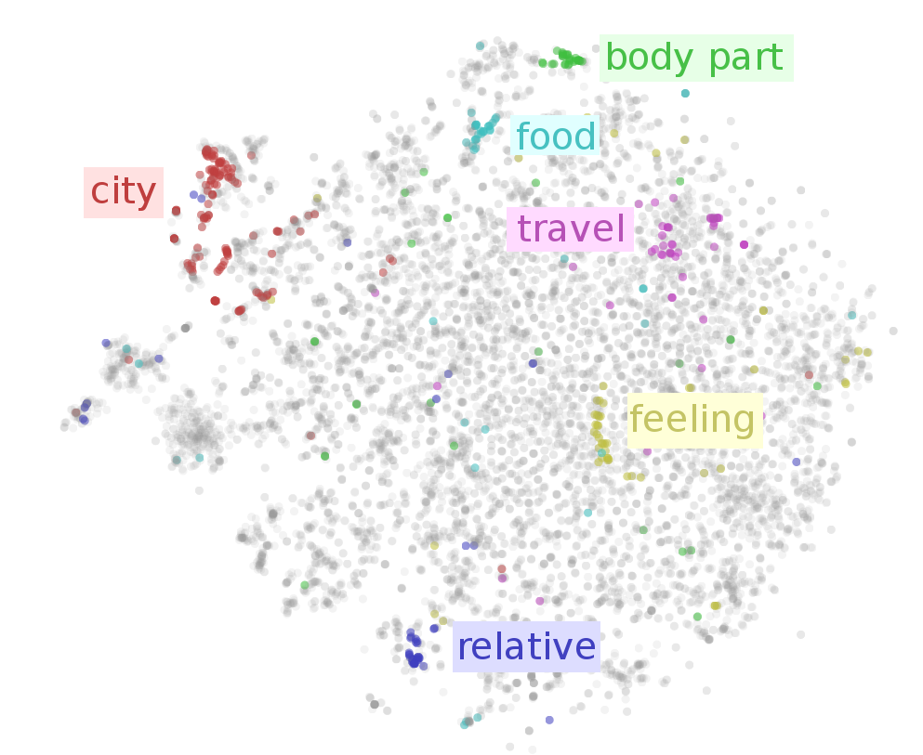
Interpreting Representations
Related words appear nearby in embedding space.
Note: visualization is approximate! (typically, d = 50-300)
Image from Visualizing Representations (Chris Olah, 2015)
Also see http://projector.tensorflow.org/

Slide 34
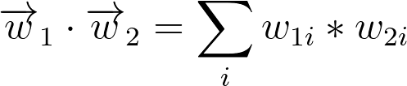
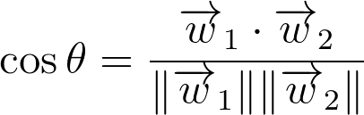
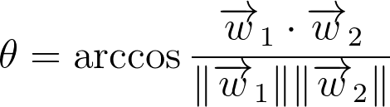
Word-to-Word Similarity
Dot product Scores overlap between individual words However...score is unnormalized Larger vectors get higher scores
Cosine Normalizes dot product by vector length However...scores can violate triangle inequality sim (a, c) ≤ sim(a,b) + sim(b,c)
Arccosine Converts to angular distance Triangle inequality now holds!
bike
car
truck
Notes:
Common words can have large vectors, but this doesn't mean they are more similar to all other words.
\overrightarrow{w}_{1} \cdot\overrightarrow{w}_{2} = \sum_i w_{1i}*w_{2i}
\cos \theta = \frac{\overrightarrow{w}_{1} \cdot\overrightarrow{w}_{2} }{\|\overrightarrow{w}_{1}\| \|\overrightarrow{w}_{2}\|}
\theta = \arccos \frac{\overrightarrow{w}_{1} \cdot\overrightarrow{w}_{2} }{\|\overrightarrow{w}_{1}\| \|\overrightarrow{w}_{2}\|}

Slide 35
Exercise
Word Vectors
E(“dog”) = [3 0]
E(“cat”) = [2 1]
E(“mouse”) = [2 -1]
Question
Is “Cat” closer to “Mouse” or “Dog”
Answer? <<Please calculate & put in chat!>>
Notes:
Would be nice if we can bridge between contexts, by multi-hop reasoning: {beijing, boston, honolulu} are similar, and {boston, london} are similar, so maybe {london, beijing} are similar, transitively?

Slide 36
Exercise
Word Vectors
E(“dog”) = [3 0]
E(“cat”) = [2 1]
E(“mouse”) = [2 -1]
Question
Is “cat” closer to “mouse” or “dog”
Answer
cos(“dog”, “cat”) = 0.89
cos(“mouse”, “cat”) = 0.60
➣ “‘Cat’ is closer to ‘dog’ than ‘mouse’”!
“cat”
“dog”
“mouse”
Notes:
Would be nice if we can bridge between contexts, by multi-hop reasoning: {beijing, boston, honolulu} are similar, and {boston, london} are similar, so maybe {london, beijing} are similar, transitively?

Slide 37
How to train? Unsupervised training
Training word representations without a supervised task!!!
Key idea Word representations should predict their context and vice versa. Mechanisms
Skip-gram: Train representations to predict context around a word CBOW: Train representation to predict word from surrounding context
Notes:
Distributional hypothesis: let’s try to learn meaning of words (as vector representation), by predicting the words around them.

Slide 38
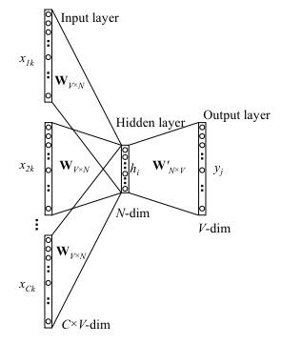
CBOW - Continuous Bag-of-Words
Predicts a word given its context - P(word|context)
1.“Embeddings empower more accurate classification”
2.“Embeddings empower less accurate classification”
3.“Embeddings empower spaceship accurate classification”
Mechanism
Predict middle word using avg. context representation.
Maximizes P(word | avg(context))
P(more| avg(embeddings, empower, accurate, classification))
Learn W and W’ matrices - W is embedding matrix
Word2vec parameter learning explained
Notes:
RAW = “Someone give me a sentence” y = “me”
X = [“someone”, “give”, ….., …”sentence”]

Slide 39
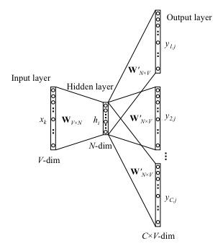
Skip-Gram Model
Predicts context around a word - P(context|word)
“Embeddings empower more accurate classification”
Mechanism
Randomly samples R words from context window
Positive word pairs (more, embeddings)(more, empower) AND negative word pairs
Maximizes P(context_{i∈R} | word_{t})
Learn W and W’ matrices - W is embedding matrix
Word2vec parameter learning explained

Slide 40
Paper Peek
-> Efficient Estimation of Word Representations in Vector Space <-
See also: word2vec Parameter Learning Explained for detailed explanation
Notes:
discussion of grounding problem, ambiguity in language

Slide 41
Word Embeddings Summary
Independently useful - captures semantic similarity between words.
Natural product of training a neural network on some natural language task.
However, does not require labeled data!
Unsupervised Methods Word2Vec GloVe FastText Misc. others...
Allows for combination of supervised and unsupervised training
Notes:
Others include: LexVec, Paragram, C-PHRASE

Slide 42
Now we are ready:
Classification with NNs

Slide 43
Why Neural Nets?
Powerful learned representations
Input: Word embeddings
Internal Transforms: Multiple hidden layers to refine representation
Both learn jointly with task objective!
Deep computation (multiple layers) allows
Complex decision boundary
Fewer parameters than big shallow network
Key: avoid sparsity problem by computing in dense space
Without sacrificing representation power
Notes:
Of course, must always be careful to avoid overfitting. Neural networks can be very powerful, and overfit in more subtle ways than big sparse models.

Slide 44
Neural Bag of Words Model
Discussion:
What to use for binary decisions, what for multi-class classification?
What is the dimension of the last affine layer?
How do we interpret the softmax output?
Sigmoid Or Softmax
Affine
z = xW + b
Affine
Nonlinearity
Affine
(Literally) sum vectors
(“bag of words”)
+
e₁ e₂ e₃ e₄ e₅
w₁ w₂ w₃ w₄ w₅
Notes:
2-4 minute slide. Discuss network end-to-end starting with input word embeddings, summation to get sentence representation, feed through DNN layers and then used for softmax classification.

Slide 45
Combining Supervised+Unsupervised
Sigmoid Or Softmax
Supervised task Trains hidden and output layers
Unsupervised task Trains word embeddings
Why?
Affine
Nonlinearity
Supervised (e.g., Sentiment)
Affine
Sum vectors
(“bag of words”)
+
e₁ e₂ e₃ e₄ e₅
Unsupervised (e.g., Word2Vec)
w₁ w₂ w₃ w₄ w₅

Slide 46
Combining Supervised+Unsupervised
Sigmoid Or Softmax
Supervised task Trains hidden and output layers
Unsupervised task Trains word embeddings
Why?
More unsupervised than supervised data
Word level task transfer
Effectiveness depends on task and quantity of supervised data.
Affine
Nonlinearity
Supervised (e.g., Sentiment)
Affine
Sum vectors
(“bag of words”)
+
e₁ e₂ e₃ e₄ e₅
Unsupervised (e.g., Word2Vec)
w₁ w₂ w₃ w₄ w₅

Slide 47
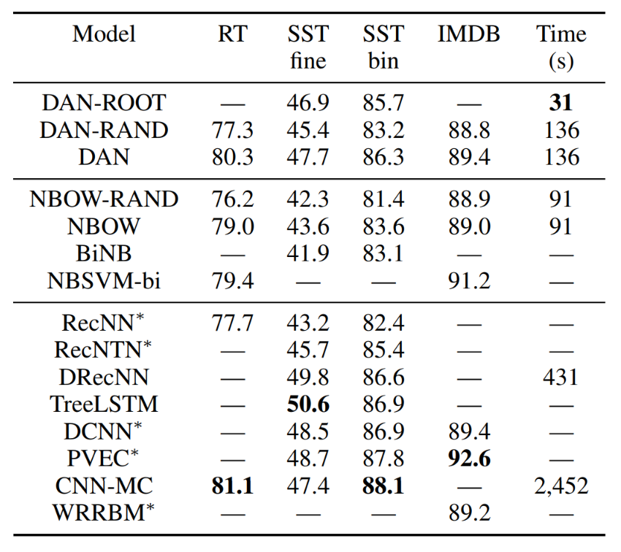
Effectiveness
Deep Unordered Composition Rivals Syntactic Methods for Text Classification (Iyyer et al., 2015)
Deep Averaging Network (DAN)
Fast! Easy to Implement! + Competitive with more sophisticated models

Slide 48
Implementation Details: Tuning Hyperparameters
Many things to try:
Vocabulary size
Word vector size
Hidden layer size
Learning rate
Minibatch size and training schedule
Sampled loss functions?
Dropout?
Optimizer (SGD, AdaGrad, Adam, RMSProp, etc.)?
True for non-neural algorithms too! But NNs can be very sensitive.

Slide 49
Implementation Details: Tuning Hyperparameters
How to tune?
Guess sensible defaults, based on similar work
We’ll give you these for assignments
Grid search: try all combinations (slow!)
Alpha = [0.1, 0.01, 0.001]
Lambda = [1.0, 0.1, 0.01]
H = [50, 100, 200, 500]
Random search (much better!)
Fancy: automatic tuning (gaussian processes, etc.)
No perfect solution...

Slide 50
Back to Classification
Beyond Neural Bag-of-Words
Convolutional Neural Networks Week 5
Shared weights and incremental local pooling for better representations
Recurrent Neural Networks Week 6
Sequentially processes text with hidden state tracking current interpretation
Pooling
The
cat
in
the
Shared Weights
The
cat
in
the

Slide 51
End.
Next week Part of Speech tagging and Parsing

Slide 52

Halp! Where should I start?

Slide 53
Thought Exercise on Sentence Classification
Problem: classify as positive or negative: “This movie could be better” -> - “That flick should have been stronger” -> - “The film could have been strong” -> ?
How to approach programmatically?
Simplest approach: ?
Problem with this: ?
Better approach: ?
Remaining Problem:
?
?

Slide 54
Types of Models
Be sure to use the right tool for the job! The literature is a great resource here, but there are many models we won’t see until later in the course.
Different problems use different ML architectures:
Unsupervised
Classification or regression
Sequence labeling
Retrieval, extraction, and similarity
Sequence prediction

Slide 55
Implementation Details: Debugging TensorFlow
How to debug?
Many errors checked at graph construction
Look at Tensor shape: tf.shape(x_) or x_.get_shape(), like in NumPy
Test on small data:
output = session.run(output_, feed_dict={input_: inputs[:3]})
TF does a lot for you! Use high-level functions instead of rolling your own.
tf.nn.embedding_lookup(...)
tf.nn.dynamic_rnn(...)
tf.nn.sparse_softmax_cross_entropy_with_logits(...)
And many more!
Notes:
Links are broken - update!

